Slide 1
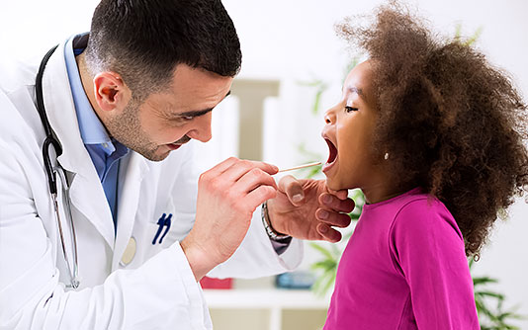
At the doctor’s

Slide 2
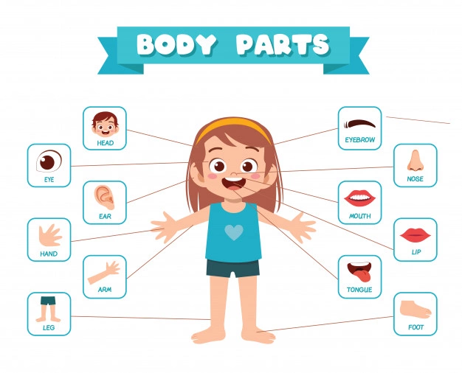
Do you know these body parts?

Slide 3
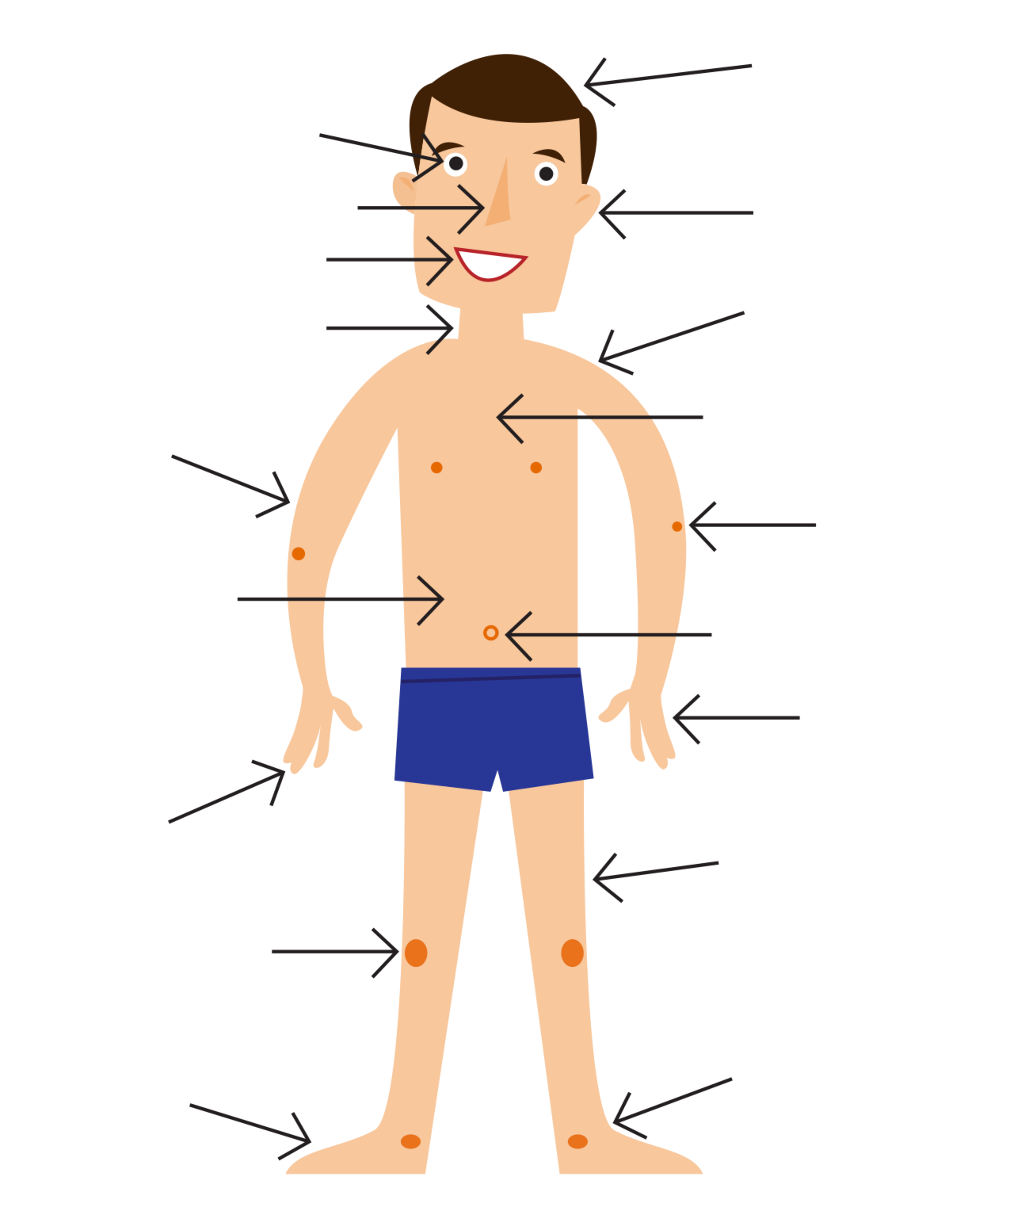
Can you label these?
ear arm hair foot finger chest hand elbow stomach (belly) belly button finger knee leg nose mouth shoulder hand neck
by coach
by bus

Slide 4
Can you label these?
hair
eye
ear arm hair foot finger chest hand elbow stomach (belly) belly button finger knee leg nose mouth shoulder hand neck
nose
ear
mouth
shoulder
neck
arm
chest
elbow
stomach (belly)
belly button
hand
finger
leg
knee
toe
foot

Slide 5
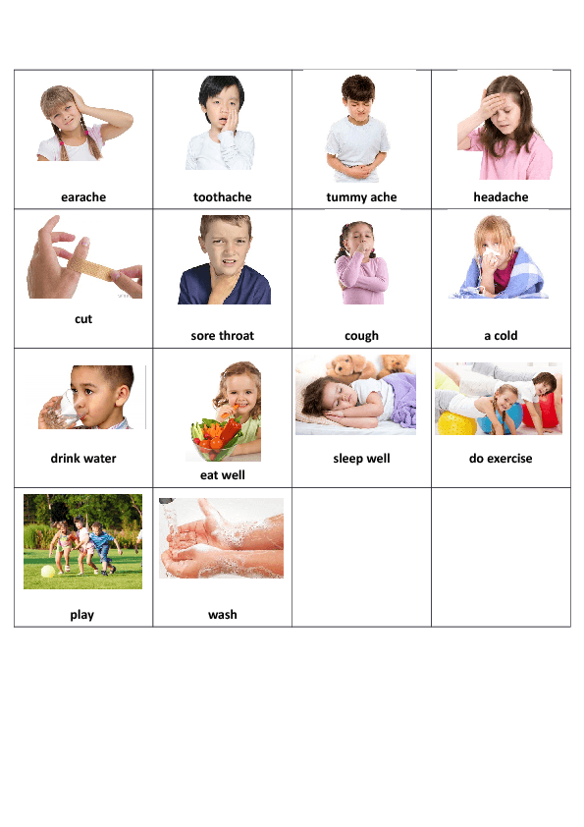
I have a/an …. have + illnesses
a toothache a cut an earache a cough a cold
a stomach ache (tummy ache) a headache a sore throat

Slide 6
I have a/an … have + illnesses
a toothache a cut an earache a cough a cold
a stomach ache (tummy ache) a headache a sore throat

Slide 7
Where can you hear these conversations?
 | …? |  | Place
1. | What is the matter? What can I do for you today? | A. | hospital
2. | I’m looking for the x-ray department. | B. | doctor’s surgery
3. | I have a prescription for some antibiotics. | C. | GP reception
4. | I would like to make an appointment with dr. Cox. | D. | pharmacy
5. | The nurse will see you now. | E. | treatment room

Slide 8
Symptoms and illnesses. Can you match them?
 | Illness |  | Symptom
1. | Flu (influenza) | A. | Sore throat
2. | Cough | B. | Sneezing
3. | Cold | C. | Bleeding
4. | Backache | D. | Sore back, can’t move
5. | Cut finger | E. | Red marks on the skin
6. | Rash | F. | Fever and chills

Slide 9
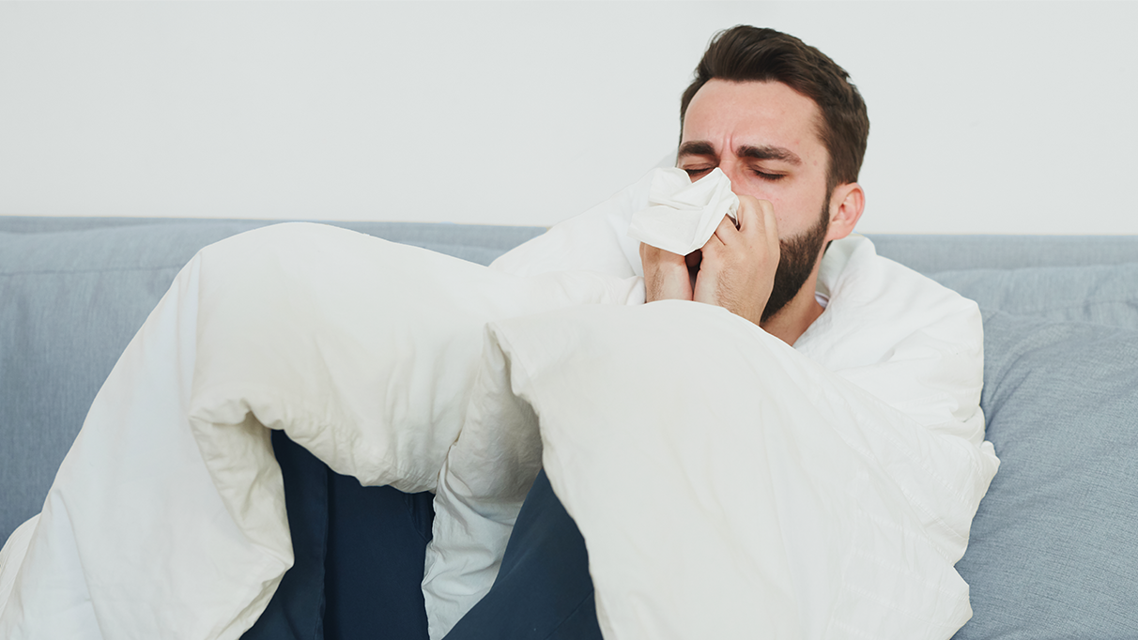
What is the matter? Complete these dialogues.
 | I’m not feeling well.
1. | Tom: Atchoo! Atchoo! Daisy: Bless you! Are you 1. _____? Tom: I think I have a 2. ______. Daisy: Do you have a high 3. _____? Tom: I think so. I also feel very 4. _____. Daisy: You should stay at home and 5. _____. You can’t go to work like this! Tom: You’re right. I will 6. _____ in sick. | cold okay temperature rest weak call

Slide 10
What is the matter? Complete these dialogues.
 | I’m not feeling well.
1. | Tom: Atchoo! Atchoo! Daisy: Bless you! Are you 1. _okay__? Tom: I think I have a 2. _cold__. Daisy: Do you have a high 3. _temperature__? Tom: I think so. I also feel very 4. __weak_. Daisy: You should stay at home and 5. __rest___. You can’t go to work like this! Tom: You’re right. I will 6. _call_ in sick. | cold okay temperature rest weak call

Slide 11
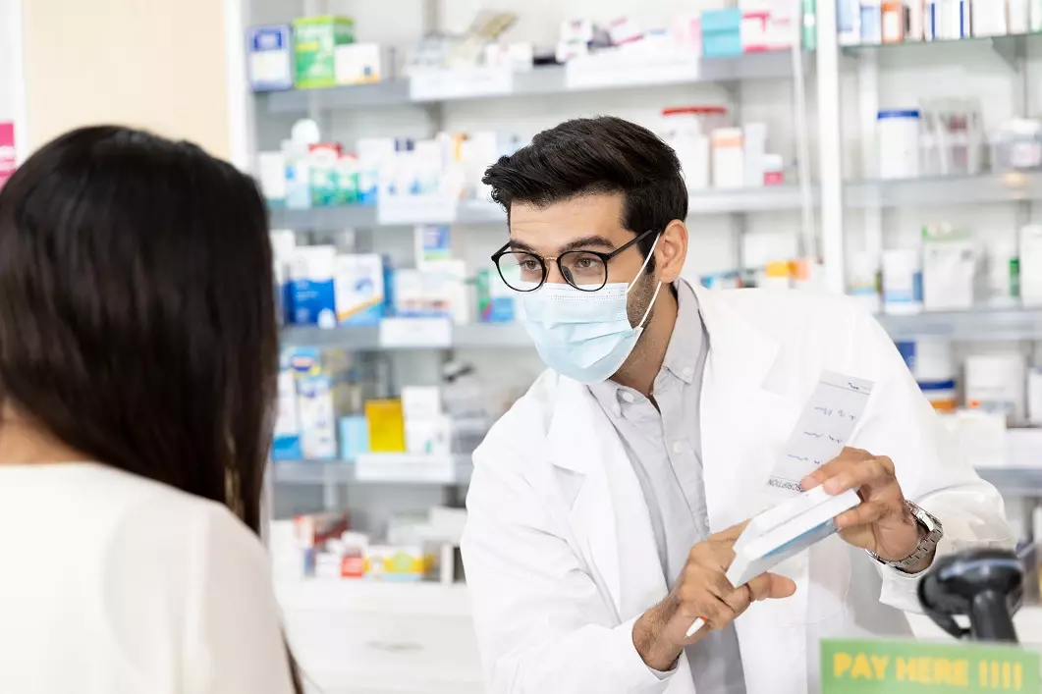
What is the matter? Complete these dialogues.
 | At the pharmacy
2. | Pharmacist: Hello, can I 1. ____you? Customer: Yes, I think I have a 2. _____. I need some 3. _________. Pharmacist: How about some 4. _______? Customer: That’s great. I also need a 5. _____ syrup. Could you also give me a box of 6.______? I keep sneezing a lot. Pharmacist: No problem, here you are. Remember to call your doctor if you don’t 7. _______ in the next few days. Customer: I’ll do that. Thank you. | medicines cold get better help cough tissues paracetamol

Slide 12
What is the matter? Complete these dialogues.
 | At the pharmacy
2. | Pharmacist: Hello, can I 1. _help___you? Customer: Yes, I think I have a 2. __cold___. I need some 3. __medicines___. Pharmacist: How about some 4. _paracetamol__? Customer: That’s great. I also need a 5. _cough___syrup. Could you also give me a box of 6._tissues__? I keep sneezing a lot. Pharmacist: No problem, here you are. Remember to call your doctor if you don’t 7. _get better__ in the next few days. Customer: I’ll do that. Thank you. | medicines cold get better help cough tissues paracetamol

Slide 13
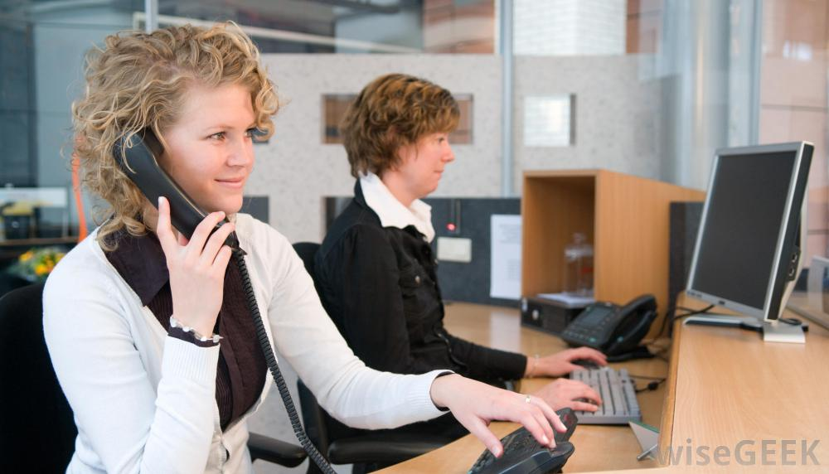
What is the matter? Complete these dialogues.
 | My daughter is sick
3. | School reception: Hello, Woodpark Primary School. Mum: Good morning, this is Diane’s mum 1. ______. School reception: Good morning. Is Diane alright? Mum: Diane’s not 2. ______ this morning. She has a 3.______ and a 4. ______. She’ll be 5. ____ from school today. Reception: That’s OK. I will let the teacher 6. _____. I hope she’ll get better 7. ______. | soon fever absent know cough calling well

Slide 14
What is the matter? Complete these dialogues
 | My daughter is sick
3. | School reception: Hello, Woodpark Primary School. Mum: Good morning, this is Diane’s mum 1. _calling___. School reception: Good morning. Is Diane alright? Mum: Diane’s not 2. __well__ this morning. She has a 3.__fever_ and a 4. __cough_. She’ll be 5. __absent__ from school today. Reception: That’s OK. I will let the teacher 6. _know____. I hope she’ll get better 7. __soon__. | soon fever absent know cough calling well

Slide 15
thanks!
Any questions?
post them in our Facebook group
?

